Slide 1
Hadoop AWS Setup step by step
By Maggie zhang

Slide 2
Three Types of Hadoop Modes
Standalone Mode
Single-Node Pseudo-distributed Mode
Fully-distributed Mode
In this practice, we will achieve the fully distributed mode to set up 4 node Hadoop AWS EC2 cluster

Slide 3
What you will target
NameNode (Master)
SecondaryNameNode
DataNode (Slave1)
DataNode (Slave2)

Slide 4
Four Major Steps
Step 1
Setting up Amazon EC2 Instances
Step 2
Setting up client access to Amazon Instances (using Putty.)
Step 3
Setup WinSCP access to EC2 instances
Step 4
Hadoop Multi-Node Installation and setup Notes: Most people have issues with Step 4. If you just need to dig in Hadoop configuration, welcome to skip to Step 4.

Slide 5
Step 1 - Setting up AWS EC2 Instances
Abstracts:
4 Node Instance Cluster
Security Group (Inbound/Outbound – all public at the very beginning)
Security Pair Key

Slide 6
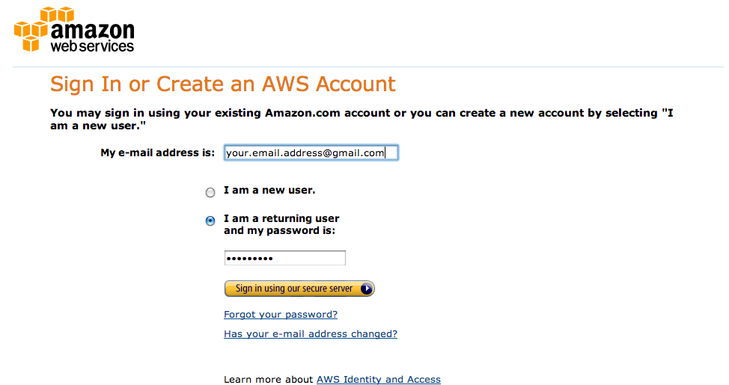
1.1 Get Amazon AWS Account
eligible free-tier instances

Slide 7
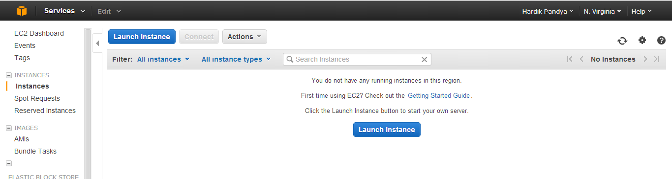
1.2 Launch Instance
Instances Console

Slide 8
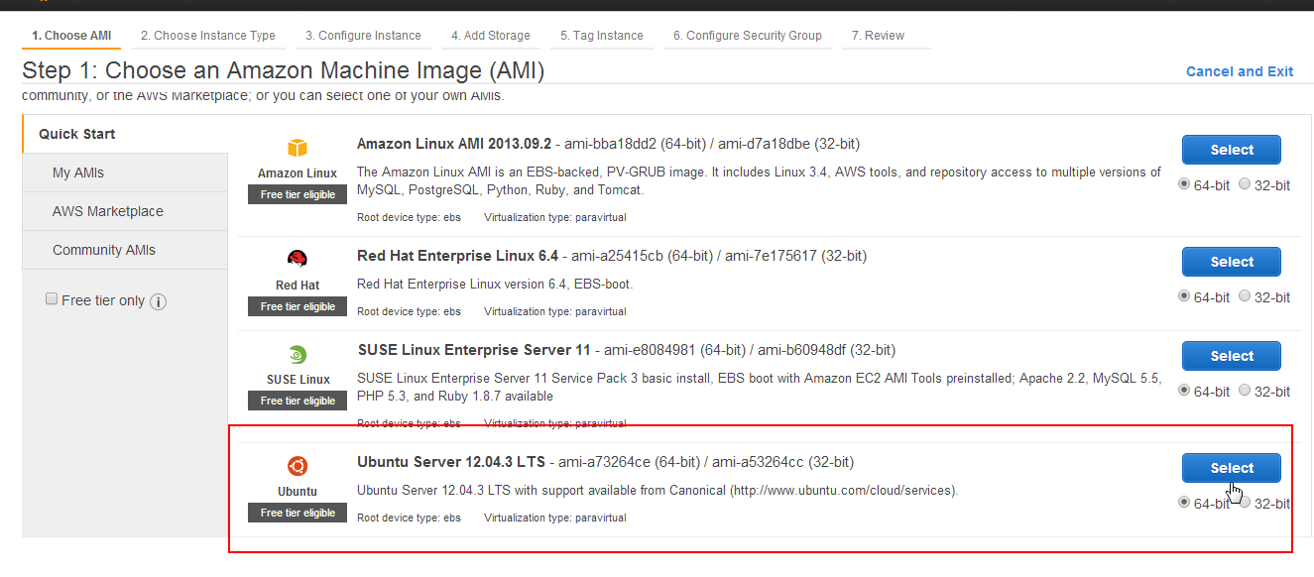
1.3 Select AMI
Recommend to use Ubuntu

Slide 9
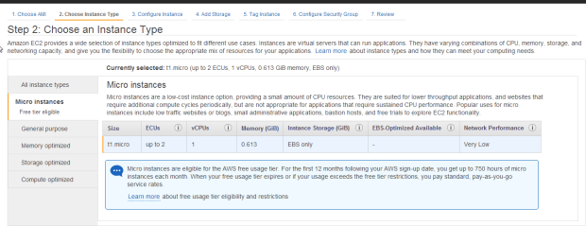
1.4 Select Instance Type
Micro

Slide 10
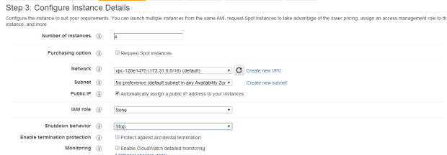
1.5 Configure Number of Instances
4 Nodes

Slide 11
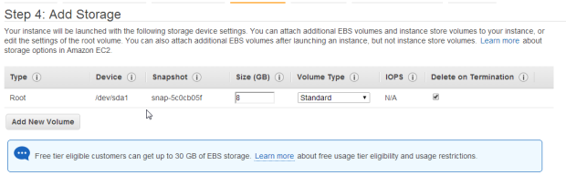
1.6 Add Storage
Minimum volume size is 8GB

Slide 12
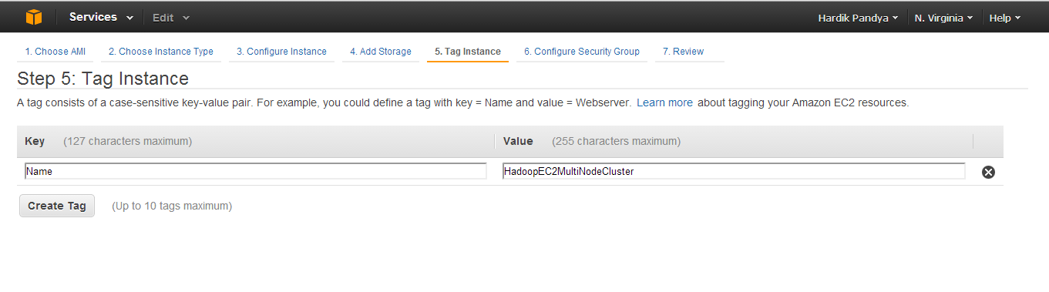
1.7 Instance Description
Give your instance name and description

Slide 13
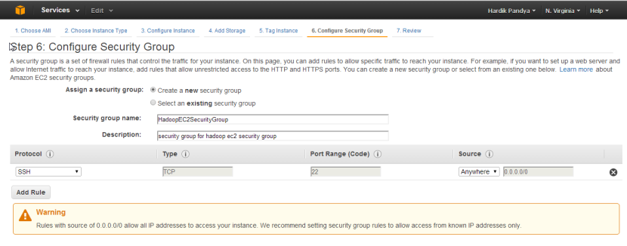
1.8 Define a Security Group
Create a new security group, later to modify the security group with security rules.

Slide 14
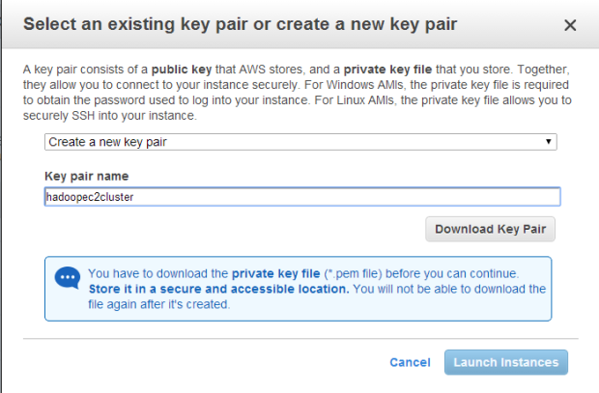
1.9 Launch Instance and Create Security
Only one new key and save it safely; Can’t change it later.

Slide 15
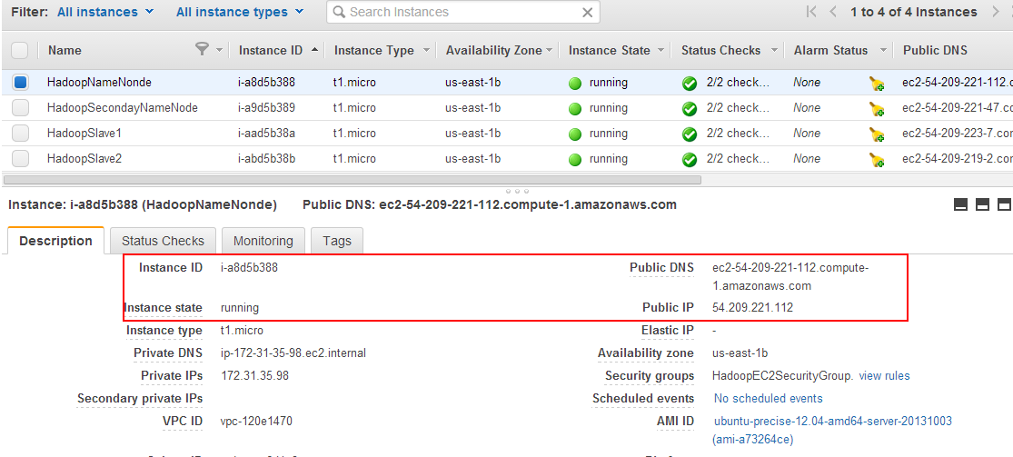
1.10 Launching Instances
Write the mapping of Public DNC/IP for 4 nodes

Slide 16
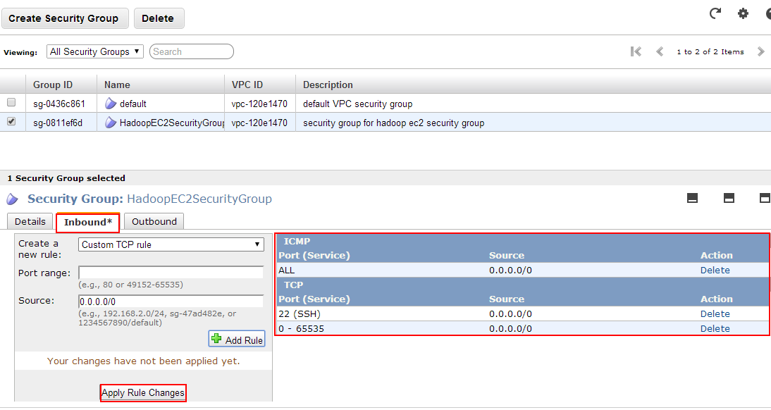
1.11Change Instance Security Group
Make sure to assign the same security group to 4 nodes

Slide 17
Step 2 – Putty Setting up client access
Abstracts:
Pem key to ppk key
Username for Ubuntu AWS - Ubuntu
Passphraseless Communication among nodes

Slide 18

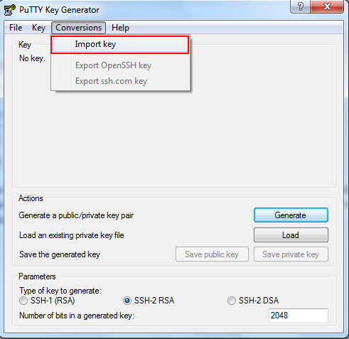
2.1 Generating Private Key
Using PUTTYGEN to generate

Slide 19
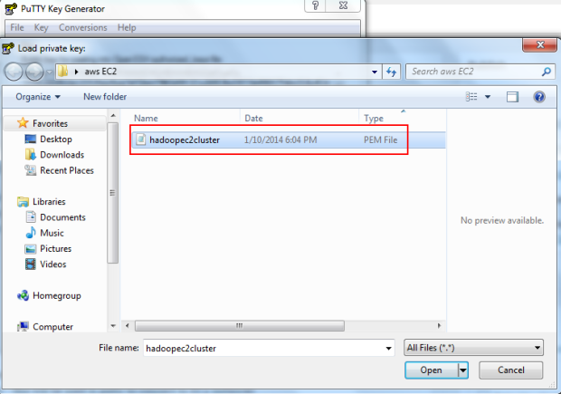
2.1 Generating Private Key
Loading private key

Slide 20
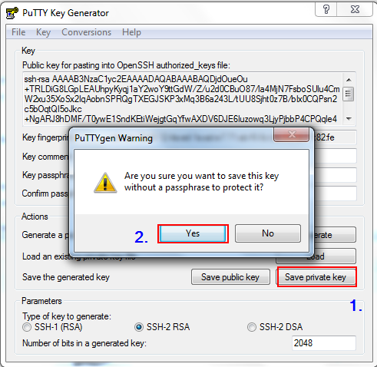
2.2 Save Private Key
Loading private key

Slide 21
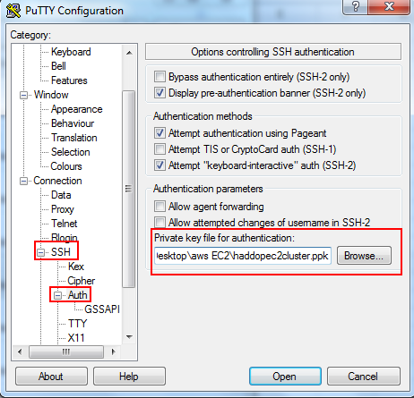
2.3.1 Provide private key for authentication

Slide 22
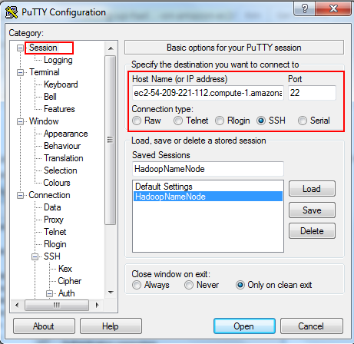
2.3.2 Hostname/Port and Connection Type

Slide 23
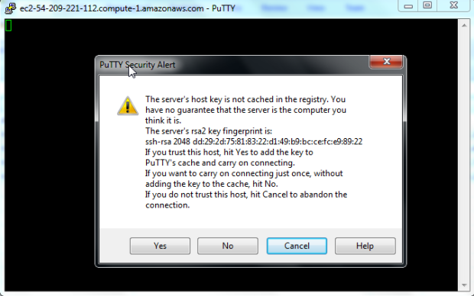
2.3.2 Hostname/Port and Connection Type

Slide 24
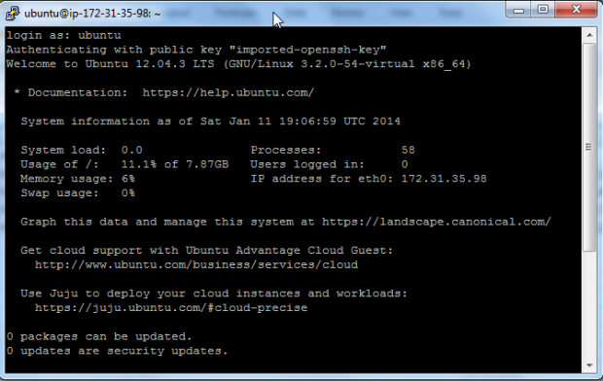
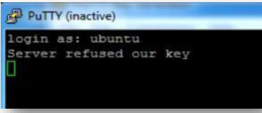
2.3.3 Login in using Ubuntu & Key
If there is a problem with your key, you may receive below error message

Slide 25
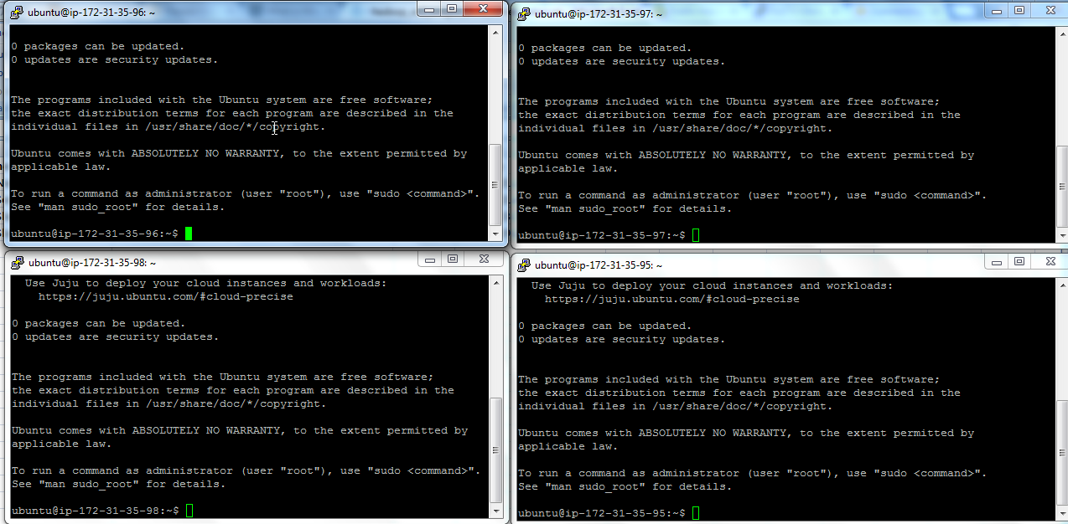
2.3.4 Connect to all 4 nodes

Slide 26
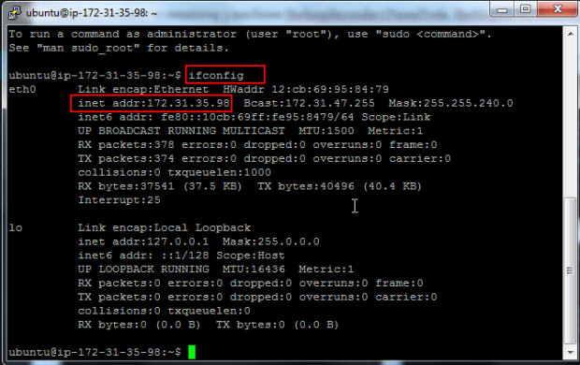
2.4.1 Enable Public Access
REPEAT ON ALL 4 NODES

Slide 27
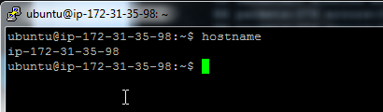
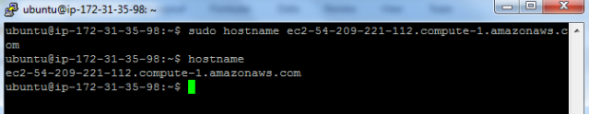
2.4.2 Change Host Names
$ sudo hostname ec2-54-209-221-112.compute-1.amazonaws.com

Slide 28
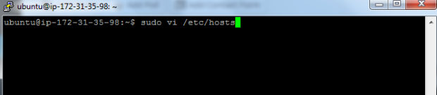
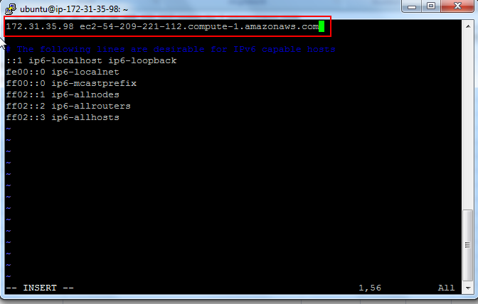
2.5 Modify /etc/hosts
REPEAT ON ALL 4 NODES

Slide 29
Step 3 - Setup WinSCP access to EC2
Abstracts:
Hostname
User name - Ubuntu
Using .PPK key

Slide 30

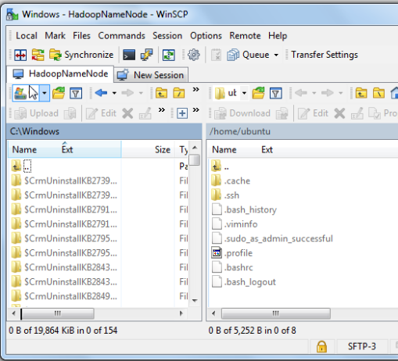



3.2 File Transfer Interfaces

Slide 31
2.5 Modify /etc/hosts
REPEAT ON ALL 4 NODES

Slide 32

Made Easiest Parts! Fun Parts Coming!

Slide 33
Step 4 - Hadoop Installation and setup
Abstracts:
Install Jave
Install Hadoop
Passphraseless Access
Configurations
Run Java Programs
Internet User Interface

Slide 34
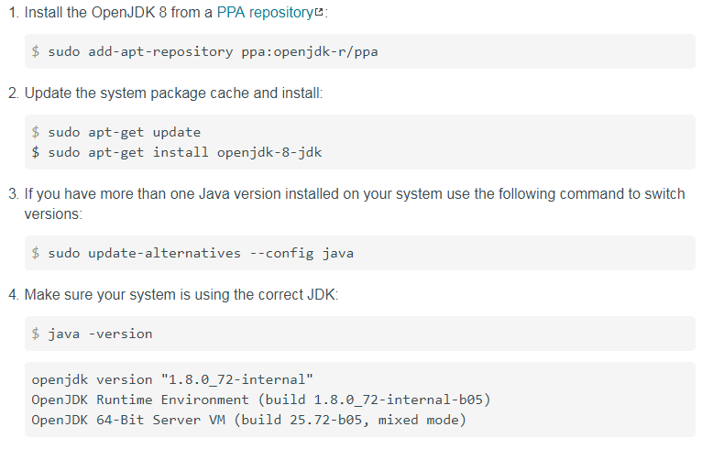
4.1.1 Install Java REPEAT ON EVERY NODE

Slide 35
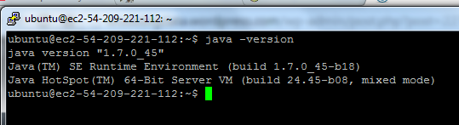

4.1.2 JAVA Home Configuration REPEAT ON EVERY NODE
$ vim ~/.bashrc
Better check the directory first otherwise JAVA program can’t run functionally if JAVA_HOME is wrong

Slide 36
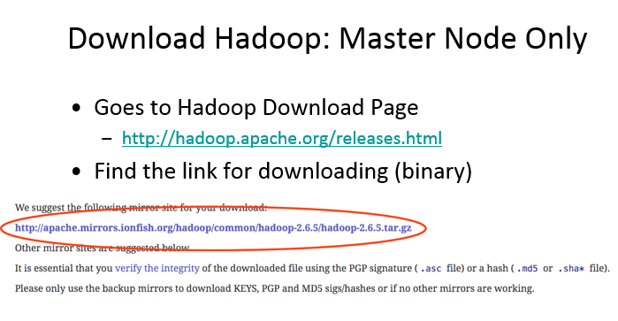
4.2.1 Download Hadoop version 2.6.5 (Master node only)

Slide 37
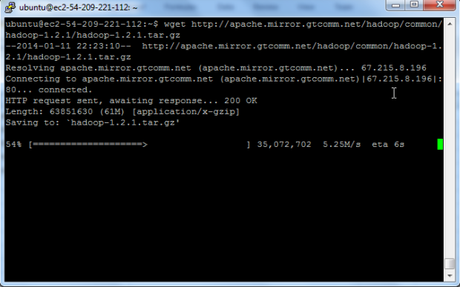
4.2.2 Hadoop Installation (Master node only)
$ mkdir ~/Downloads $ wget http://apache.mirrors,tds.net/hadoop/common/Hadoop-2.6.5/hadoop-2.6.5.tar.gz -P ~/Downloads $ sudo tar zxvf ~/Downloads/hadoop-* -C /home/Ubuntu $ sudo mv /home/Ubuntu/hadoop-* /home/ubuntu/Hadoop Notes: This will install Hadoop under the directory home/ubuntu. You can use WinSCP to see it and its files now. You also can use WinSCP to modify the files directly and transfer files among Nodes.

Slide 38
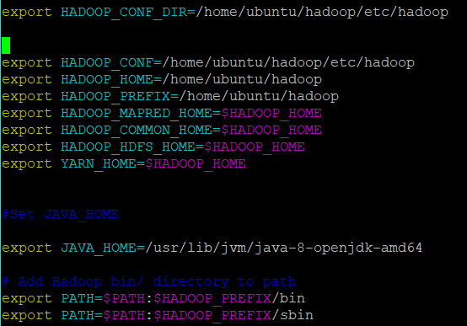
4.3 Set up Environment Variable
REPEAT ON ALL 4 NODES
$ vi ~/.bashrc
Add the picture code
Esc + : + w to save
Esc + : + q to quit
$ source ~/.bashrc
echo $HADOOP_PREFIX echo $HADOOP_CONF

Slide 39
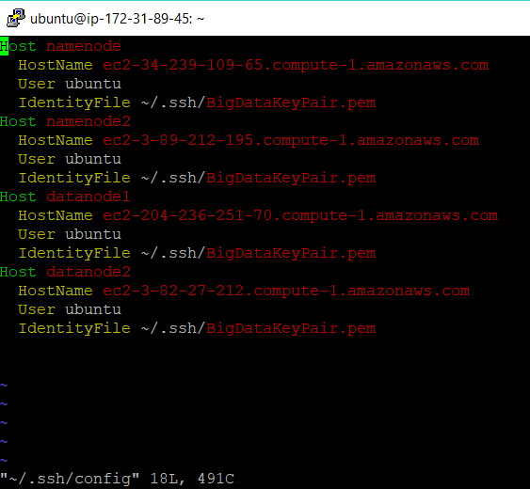
4.4.1 Set up Passphraseless SSH on Servers
REPEAT ON ALL 4 NODES
$ vi ~/.ssh/config
Using WinSCP copy .pem to the directory ~/.ssh/
$ chmod 644 authorized_key
$ chmod 400 BigDataKeyPair.pem
$ ssh-keygen –f ~/.ssh/id_rsa – t rsa – P “”
$ cat ~/.ssh/id_rsa >> ~/.ssh/authorized_keys
$ cat ~/.ssh/id_rsa | ssh namenode2 ‘cat >> ~/.ssh/authorized_keys’
$ cat ~/.ssh/id_rsa | ssh datanode ‘cat >> ~/.ssh/authorized_keys’
$ cat ~/.ssh/id_rsa | ssh datanode2 ‘cat >> ~/.ssh/authorized_keys’

Slide 40
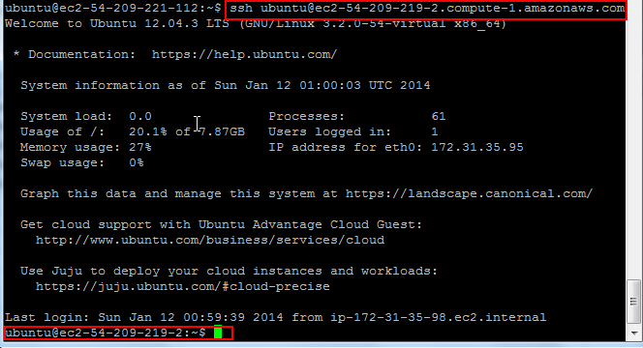
4.4.2 Remost SSH
REPEAT ON ALL 4 NODES
$ ssh namenode
$ ssh namenode1
$ ssh datanode1
$ ssh datanode2
$ ssh ubuntu@<your-amazon-ec2-public URL>
May not work anymore.
Use name stated in config

Slide 41
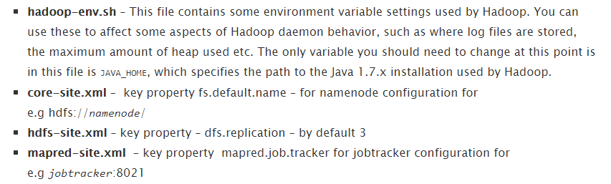
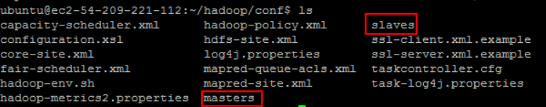
4.5 Hadoop Cluster Setup
Only Namenode; until finishing all then copy to other nodes.

Slide 42
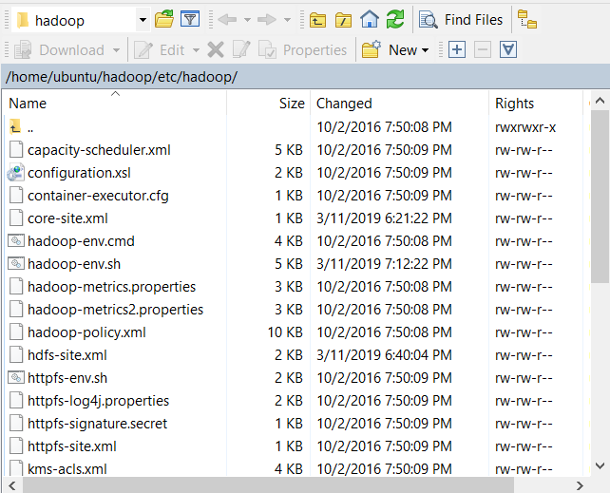
4.5.1 Configuration Directory
Using WinSCP
hadoop-env.sh
core-site.xml
hdfs-site.xml
mapred-site.xml.template
Slaves
Master( starting 2.6.5 NO NEED)
Secondarynamenode in hdfs-site.xml

Slide 43
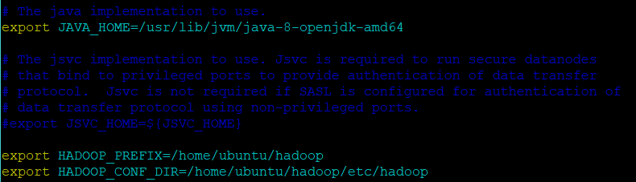
4.5.2 hadoop-env.sh
Using WinSCP

Slide 44
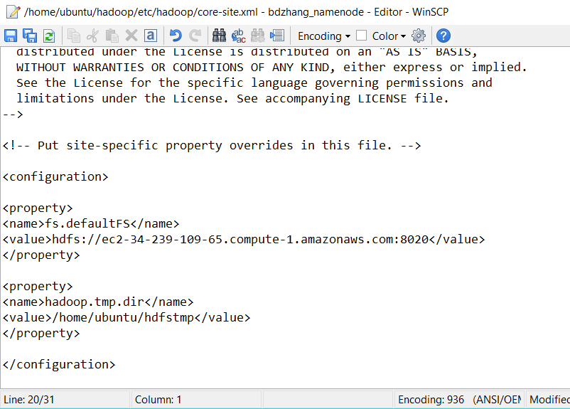
4.5.3 core-site.xml
Using WinSCP

Slide 45
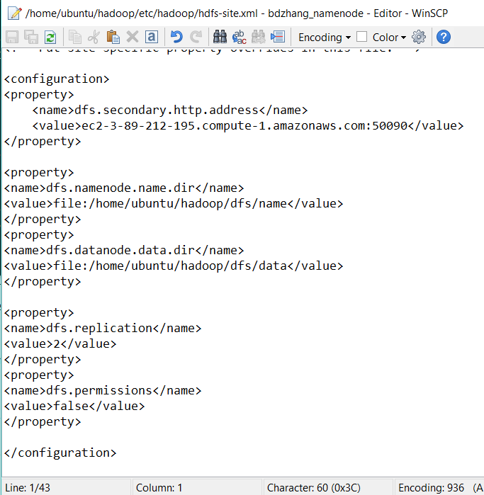
4.5.4 hdfs-site.xml
Using WinSCP

Slide 46
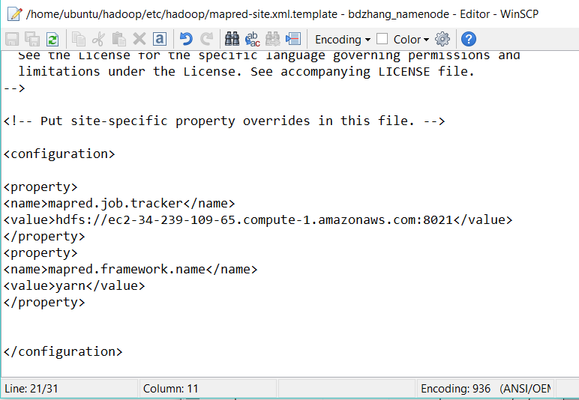
4.5.5 mapred-site.xml
Using WinSCP

Slide 47
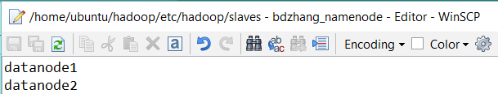
4.5.6 slaves
Using WinSCP
AWS EC2 Name changes!
Need to modify all related names!

Slide 48
4.5.7 Send Hadoop to all other nodes
$ scp –r hadoop namenode1:~
$ scp –r hadoop datanode1:~
$ scp –r hadoop datanode2:~
If changes files after this, using WinSCP to transfer

Slide 49
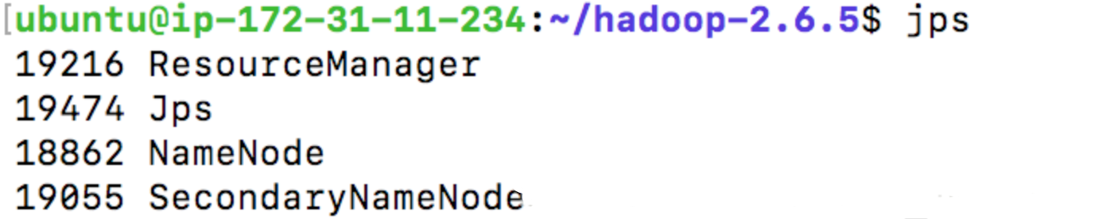
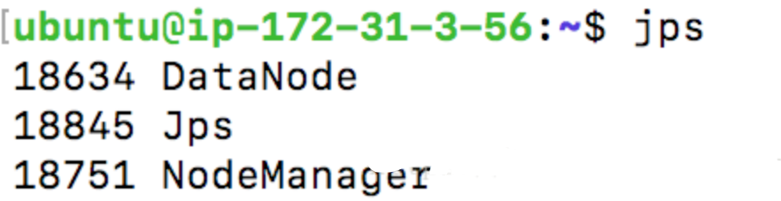
4.5.8 Format Namenode and Start Hadoop
$ hdfs namenode -format
$ start-dfs.sh
$ start-yarn.sh

Slide 50
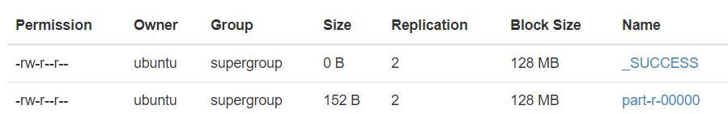
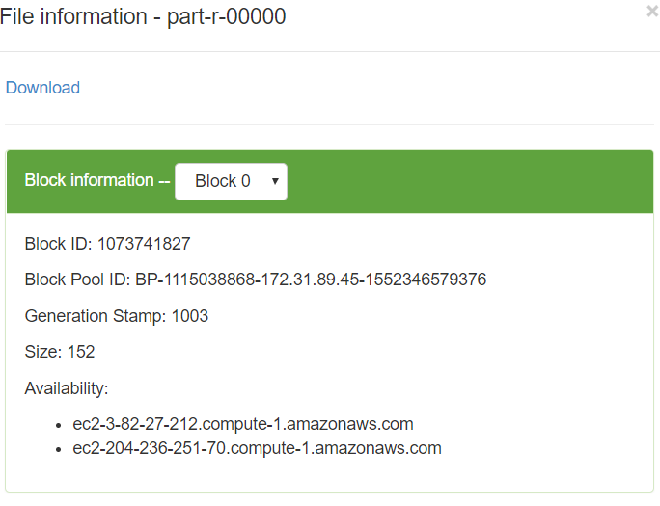
4.7 Get Result
$ hdfs dfs –get /output

Slide 51
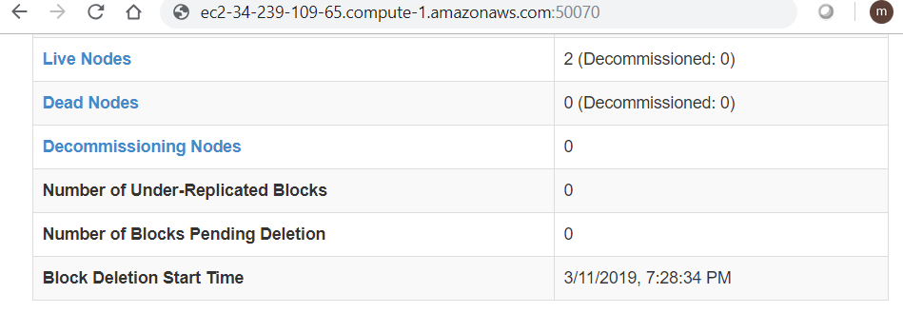
4.8.1 Web Interface

Slide 52
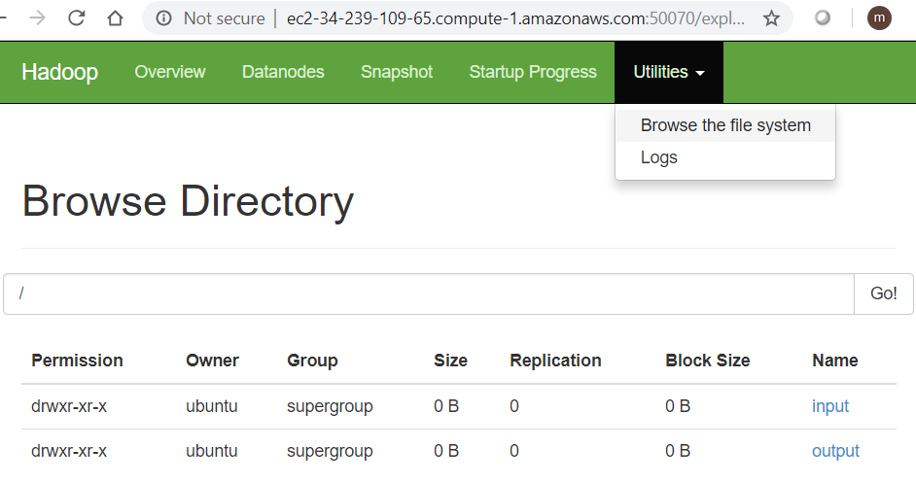
4.8.2 View Input and Output Web Interface
Calculated Result is here to download and see how many nodes participates

Slide 53

MAPREDUCE JAVA PROGRAM COMING NEXT ROUND!

